Slide 1


Competition and innovation:
Evidence from worldwide corporate R&D spenders
Michele Cincera
Université libre de Bruxelles, iCite and ECARES
Ela Ince
EC, JRC Petten
Anabela Santos
EC, JRC Seville, B7 Unit
STATEC
June 24, 2024

Slide 2
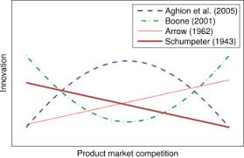
Policy question: What is the effect of competition on innovation and on productivity growth?

Slide 3
Agenda
1. Theory
2. Mixed empirical evidence
3. Data and empirical framework
4. Descriptive statistics
5. Empirical findings
6. EU RDI state aids’ rules
7. Conclusion

Slide 4
A few words about me
Full time Professor of economics at ULB, SBS-EM, iCite
Determinants and economic performances of firms’ RDI activities
  TFP, R&D efficiency, R&D spillovers, eco-system,…
  R&D expenditures, patents, scientific publications
Evaluation of socio-economic impact of RDI programmes/policies
  FTI, Eurostars2, Eureka, ERDF 2014-2020,…
  Evaluation of RDI state aids regulatory framework
  DiF, econometric models, HEFTIGE, REMOLO, semi-structured interviews, seminars with experts,…
Last 2 years:
  COVID19: vaccination intent, fears of citizens, Conjoint analysis, WFH, AI ML
  TWIN transition towards sustainable and digital management practices (cf. CONCORDi IX), Open strategic autonomy
Technological complexity

Slide 5
1. Theory
Schumpeter (1943)
  High number of firms in a market leads to decreasing expected returns of R&D
  Due to market imperfections (e.g. uncertainty of R&D, sunk costs,…), only firms with a certain level of market power will invest in R&D
Arrow (1962)
  More competition provides incentives to innovate as more R&D reduces production costs
Boone (2001)
  “An increase in the intensity of competition can increase or decrease the speed of technological progress, depending on the industry’s cost history and the initial value of competition”
Aghion et al. (2005)
  Escape competition effect: neck-and-neck firms (e.g. Apple vs. Samsumg)
  Schumpeterian effect: laggard firms (e.g. Nokia, Kodak, Blackberry)
Notes:
2010/ EU (27 countries) 2.01 Belgium 2.1 United States 2.73 China (except Hong Kong) 1.76 Japan 3.25

Slide 6
2. Mixed empirical evidence
Table 1. Summary of main findings about impact on competition on innovation and productivity
Effect direction | Output | Author | Geographical scope
Negative | R&D expenditure | Schumpeter (1934) | Theoretical model
 | R&D expenditure | Crepon et al. (1998) | France
 | R&D expenditure | Tingvall and Poldahl (2006) | Sweden
 | R&D expenditure | Castellacci (2011) | Norway
 | Labour productivity | Santos et al. (2018) | Portugal
Positive | R&D expenditure | Arrow (1962) | Theoretical model
 | R&D and scientific employment | Scherer (1967) | US
 | Productivity | Haskel (1991) | UK
 | Productivity growth | Nickell (1996) | UK
 | Productivity growth | Carlin et al. (2004) | Transactions countries
 | Productivity growth | Okada (2005) | Japan
 | Productivity growth | Kato (2009) | India
 | Patent | Correa and Ornaghi (2014) | US
 | Labour productivity | Amin (2015) | India
 | Sales per employee, Labour productivity and TFP | Friesenbichler and Peneder (2016) | Eastern Europe and Central Asia
 | TFP | Santos et al. (2018) | Portugal
Non-monotonic | Technical employment | Scherer (1967) | US
 | R&D expenditure | Dasgupta and Stiglitz (1980) | Theoretical model
 | R&D expenditure | Boone (2001) | Theoretical model
 | Innovation | Carlin et al. (2004) | Transition economies
 | Patent | Aghion et al. (2005) | Worldwide (London Stock Exchange)
 | R&D expenditure | Tingvall and Poldahl (2006) | Sweden
 | R&D expenditure | Askenazy et al. (2008) | France
 | Productivity growth | Inui et al. (2012) | Japan
 | R&D expenditure | Friesenbichler and Peneder (2016) | Eastern Europe and Central Asia
 | Innovation | Crowley and Jordan (2017) | Central and East Europe and East Asia
 | Patent | Dhanora et al. (2017) | India
 | Patent | Santos et al. (2018) | Portugal
Notes:
2010/ EU (27 countries) 2.01 Belgium 2.1 United States 2.73 China (except Hong Kong) 1.76 Japan 3.25

Slide 7
3. Data and empirical framework
Data
  Source: EU Industrial R&D Investment Scoreboard, published annually by the European Commission since 2004
  https://iri.jrc.ec.europa.eu/scoreboard/2022-eu-industrial-rd-investment-scoreboard
  Firms included in the Scoreboard are headquartered in 43 countries and account for nearly 90 % of the world’s business R&D spending (EC, 2017)
  Final sample is composed of 1,867 firms over the period 2007 to 2016
Notes:
2010/ EU (27 countries) 2.01 Belgium 2.1 United States 2.73 China (except Hong Kong) 1.76 Japan 3.25

Slide 8
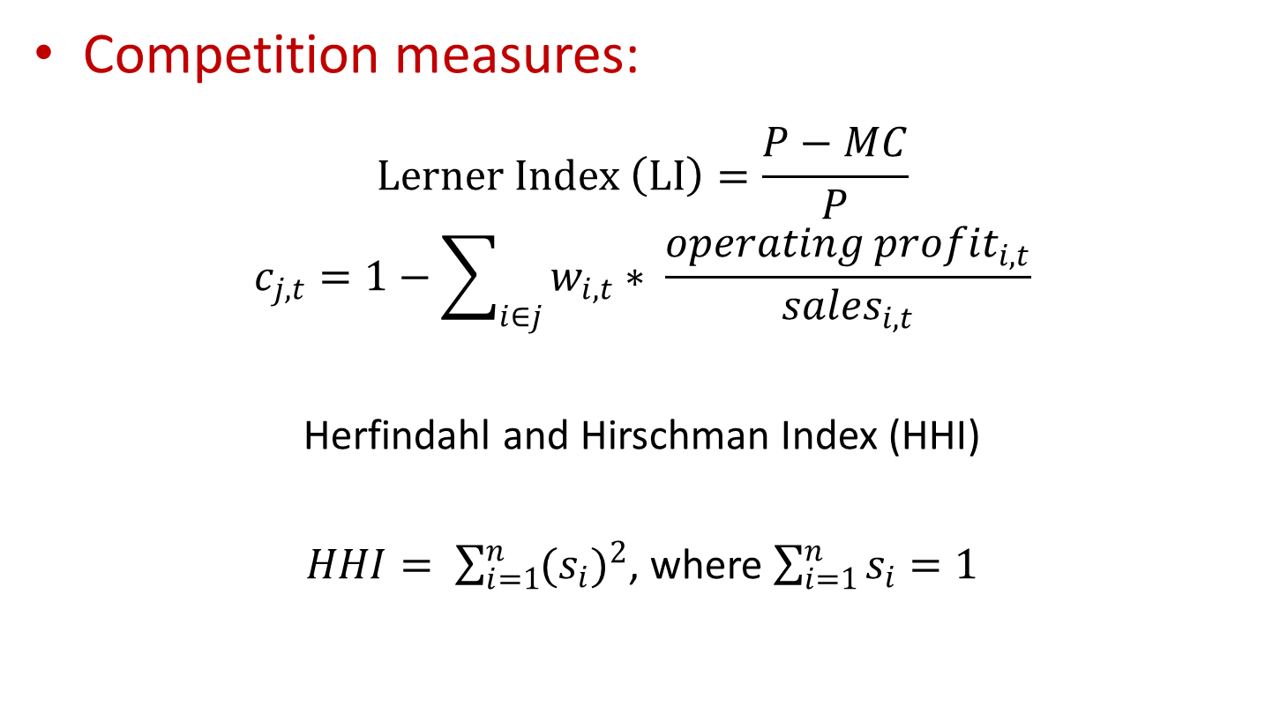
3. Data and empirical framework
Competition measures:
$$Lerner Index \left(LI\right)=\frac{P−MC}{P}$$
$$c_{j,t}=1−\sum_{i∈j}{w_{i,t}∗ \frac{{operating profit}_{i,t}}{{sales}_{i,t}}}$$
Herfindahl and Hirschman Index (HHI)
$HHI= \sum_{i=1}^{n}{{(s_{i})}^{2}}$, where $\sum_{i=1}^{n}{s_{i}=1}$
Notes:
2010/ EU (27 countries) 2.01 Belgium 2.1 United States 2.73 China (except Hong Kong) 1.76 Japan 3.25

Slide 9
3. Data and empirical framework
Relevant market
  Definition: a tool to identify and define the boundaries of competition between firms. It allows to establish the framework within which competition policy principles are applied by the Commission
  The concept is based on the characteristics of the product or the service (i.e. their degree of substitutability vs. to other similar products or services) as well as the geographical area of influence of firms (i.e. the area in which the firm and its competitors sell the product).
Notes:
2010/ EU (27 countries) 2.01 Belgium 2.1 United States 2.73 China (except Hong Kong) 1.76 Japan 3.25

Slide 10
3. Data and empirical framework
Relevant market
  Geographical scope: we limit our sample to firms that are operating in markets where products and/or services are traded worldwide, e.g.
Activity Sector (ICB) | Worldwide (Yes/No)
Aerospace & Defence | YES
Alternative Energy | No
Automobiles & Parts | YES
Banks | No
Beverages | YES
Biotechnology | YES
Chemicals | YES
Commercial Vehicles & Trucks | YES
Computer Hardware | YES
Computer Services | YES
Construction & Materials | YES
Electrical Components & Equipment | YES
Electricity | No
Electronic Equipment | YES
Electronic Office Equipment | YES
Equity Investment Instruments | No
Financial Services | No
Fixed Line Telecommunications | No
Food & Drug Retailers | No
Notes:
2010/ EU (27 countries) 2.01 Belgium 2.1 United States 2.73 China (except Hong Kong) 1.76 Japan 3.25

Slide 11
3. Data and empirical framework
Relevant market
  Product substituability
Table 3. Number of sector by ICB and NACE code classification in the sample
 | Number of sectors
ICB | 3-digits | 19
NACE | 4-digits | 198
 | 3-digits | 131
 | 2-digits | 56
Notes:
2010/ EU (27 countries) 2.01 Belgium 2.1 United States 2.73 China (except Hong Kong) 1.76 Japan 3.25

Slide 12
3. Data and empirical framework
Yollies:
  Young Leading Innovators (Cincera and Veugelers, 2014)
  Scoreboard companies that were created after 1999
Notes:
2010/ EU (27 countries) 2.01 Belgium 2.1 United States 2.73 China (except Hong Kong) 1.76 Japan 3.25

Slide 13
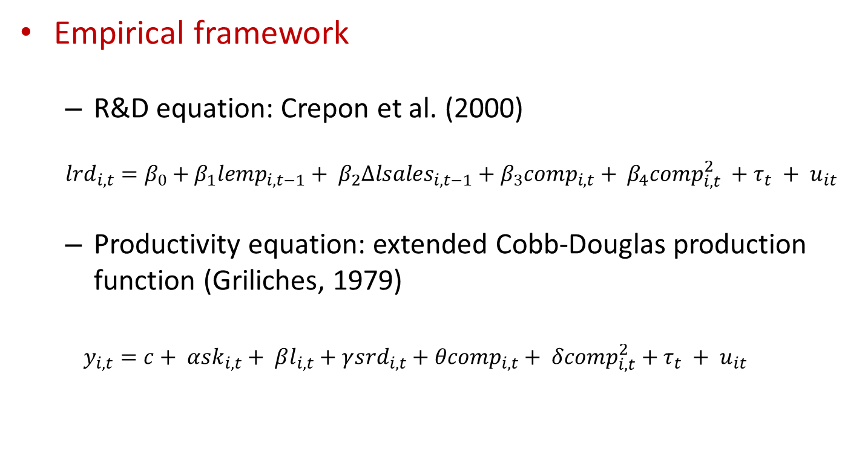
3. Data and empirical framework
Empirical framework
  R&D equation: Crepon et al. (2000)
  $${lrd}_{i,t}=β_{0}+β_{1}{lemp}_{i,t−1}+ β_{2}{∆lsales}_{i,t−1}+{β_{3}comp}_{i,t}+ β_{4}{comp}_{i,t}^{2} +τ_{t} + u_{it}$$
  Productivity equation: extended Cobb-Douglas production function (Griliches, 1979)
  $$y_{i,t}=c+ α{sk}_{i,t}+ βl_{i,t}+γ{srd}_{i,t}+{θcomp}_{i,t}+ δ{comp}_{i,t}^{2}+τ_{t} + u_{it}$$
Notes:
2010/ EU (27 countries) 2.01 Belgium 2.1 United States 2.73 China (except Hong Kong) 1.76 Japan 3.25

Slide 14
4. Descriptive statistics
Variables | Mean | Std. Dev. | Min | Max
Competition NACE 2-digits (industry-year indicator) | 0.884 | 0.051 | 0.599 | 1
Competition NACE 3-digits (industry-year indicator) | 0.880 | 0.056 | 0.599 | 1
Competition NACE 4-digits (industry-year indicator) | 0.881 | 0.057 | 0.599 | 1
Inverse market share (1-HHI) NACE 2-digits (firm-year indicator) | 0.922 | 0.107 | 0 | 0.98
R&D expenditures (€ millions, constant price) | 310 | 950 | 0 | 13,672
Net Sales (€ millions, constant price) | 7,499 | 25,448 | 0 | 481,685
N° employees | 21,822 | 49,453 | 8 | 961,000
Physical capital (Capex) Stock (€ millions, constant price) | 3,155 | 14,728 | 0 | 281,708
R&D Stock (€ millions, constant price) | 1,669 | 5,227 | 1 | 66,741
Located in EU country (Dummy) | 0.205 | 0.403 | 0 | 1
Located in non-EU country (Dummy) | 0.795 | 0.403 | 0 | 1
Yollies: year foundation > 1999 (Dummy) | 0.148 | 0.355 | 0 | 1
Ollies: year foundation < 2000 (Dummy) | 0.852 | 0.355 | 0 | 1
Small R&D spenders: world rank > 250 | 0.121 | 0.327 | 0 | 1
Large R&D spenders: world rank < 249 | 0.879 | 0.327 | 0 | 1
Notes:
2010/ EU (27 countries) 2.01 Belgium 2.1 United States 2.73 China (except Hong Kong) 1.76 Japan 3.25

Slide 15
4. Descriptive statistics
Relation between competition, innovation and productivity: high heterogeneity
Notes:
2010/ EU (27 countries) 2.01 Belgium 2.1 United States 2.73 China (except Hong Kong) 1.76 Japan 3.25

Slide 16
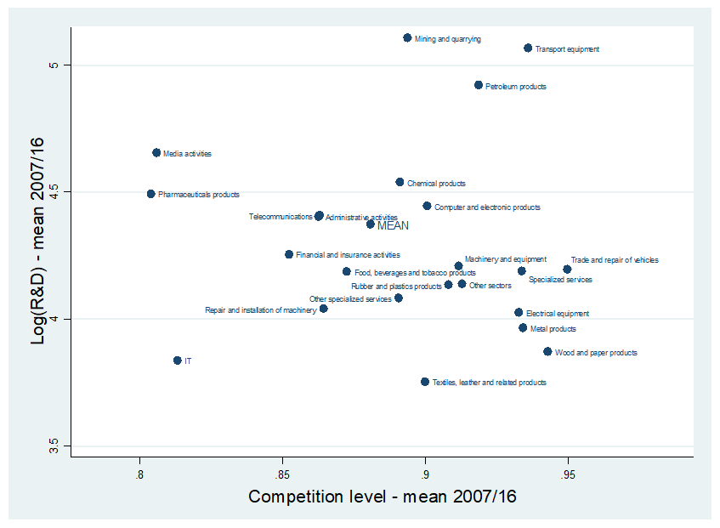
4. Descriptive statistics
Figure 4a. Relationship between competition and production, by NACE section
Notes:
2010/ EU (27 countries) 2.01 Belgium 2.1 United States 2.73 China (except Hong Kong) 1.76 Japan 3.25

Slide 17
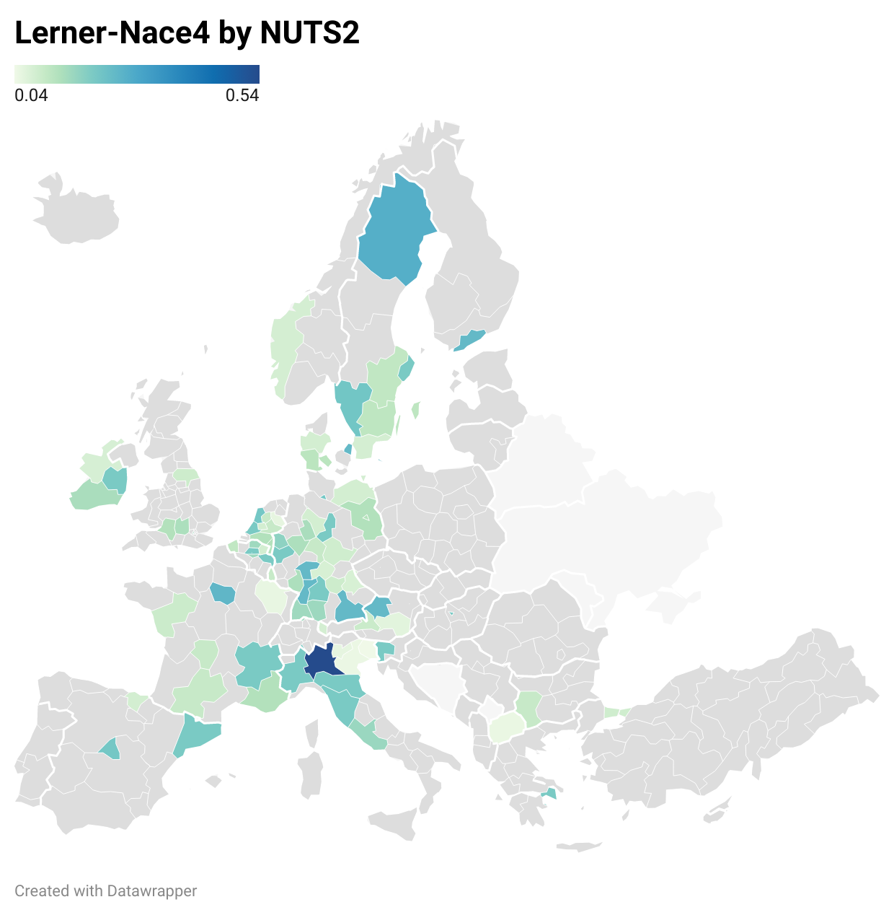
4. Descriptive statistics
Figure 4b. Relationship between competition and production, by NUTS2 regions
Notes:
2010/ EU (27 countries) 2.01 Belgium 2.1 United States 2.73 China (except Hong Kong) 1.76 Japan 3.25

Slide 18
5. Results / R&D equation
Variables | Y = Log(R&D)
 | FE | RE | IV - FE | IV – RE
 | (1) | (2) | (3) | (4)
Competition (1 - Lerner) | 9.416** | 13.10*** | 27.46*** | 18.00**
 | (3.855) | (3.700) | (7.473) | (7.411)
Competition – Squared | -5.431** | -8.038*** | -15.88*** | -9.742**
 | (2.263) | (2.170) | (4.383) | (4.330)
Growth of sales - Log in T-1 | 0.0636*** | 0.0612*** | 0.257*** | 0.259***
 | (0.0232) | (0.0227) | (0.0407) | (0.0409)
Firm size: N° employee - Log in T-1 | 0.613*** | 0.557*** | 0.537*** | 0.782***
 | (0.0387) | (0.0238) | (0.0394) | (0.0286)
Year dummy | YES | YES | YES | YES
Constant | -5.206*** | -5.923*** | -9.325*** | -7.934**
 | (1.626) | (1.585) | (3.111) | (3.116)
Observations | 12,283 | 12,283 | 12,089 | 12,089
N° of firms | 1,867 | 1,867 | 1,867 | 1,867
R-squared | 0.436 | 0.4338 | 0.3932 | 0.3774
Wald test H0: All coefficient = 0 | 0.0000 | 0.0000 | 0.0000 | 0.0000
Hausman test H0: differences in coefficients not systematic | 0.0000 |  | 0.0000
Endogenous variables | NO | NO | Competition (level and squared)
Instruments | - | - | L(1/2).Competition (level and squared)
Sargan-Hansen test H0: overidentifying restrictions are valid | - | - | 0.5094 | 0.4373
Source: Author’ own elaboration.
Note: Robust standard errors in parentheses. Significance level: *** p<0.01, ** p<0.05, * p<0.1.
Notes:
2010/ EU (27 countries) 2.01 Belgium 2.1 United States 2.73 China (except Hong Kong) 1.76 Japan 3.25

Slide 19
5. Results / R&D equation
Figure 5. Estimated relationship between competition and innovation
Source: Author’ own elaboration.
Note: Figure based on the results of IV-FE. Innovation is measured by the Log of R&D expenditure.
Notes:
2010/ EU (27 countries) 2.01 Belgium 2.1 United States 2.73 China (except Hong Kong) 1.76 Japan 3.25

Slide 20
5. Results / R&D equation
Figure 6. Estimated relationship between competition and innovation, by group:
Yollies, EU and Small R&D performers
Source: Author’ own elaboration.
Notes:
2010/ EU (27 countries) 2.01 Belgium 2.1 United States 2.73 China (except Hong Kong) 1.76 Japan 3.25

Slide 21
5. Results / R&D equation
Figure 6. Estimated relationship between competition and innovation, by group:
Yollies, EU and Small R&D performers
Source: Author’ own elaboration.
Notes:
2010/ EU (27 countries) 2.01 Belgium 2.1 United States 2.73 China (except Hong Kong) 1.76 Japan 3.25

Slide 22
5. Results / R&D equation
Figure 6. Estimated relationship between competition and innovation, by group:
Yollies, EU and Small R&D performers
Source: Author’ own elaboration.
Notes:
2010/ EU (27 countries) 2.01 Belgium 2.1 United States 2.73 China (except Hong Kong) 1.76 Japan 3.25

Slide 23
5. Results / R&D equation
Figure 7. Estimated relationship between competition and innovation, by group:
High-tech manufacturing vs. Low- and Medium-tech manufacturing industries
Source: Author’ own elaboration.
Notes:
2010/ EU (27 countries) 2.01 Belgium 2.1 United States 2.73 China (except Hong Kong) 1.76 Japan 3.25

Slide 24
5. Results / R&D equation
Figure 8. Estimated relationship between competition and innovation for incumbents and entrants
Source: Author’ own elaboration.
Notes:
2010/ EU (27 countries) 2.01 Belgium 2.1 United States 2.73 China (except Hong Kong) 1.76 Japan 3.25

Slide 25
6. Epilogue
RDI STATE AIDS RULES IN THE EU: THE ENIRI STUDY
Notes:
2010/ EU (27 countries) 2.01 Belgium 2.1 United States 2.73 China (except Hong Kong) 1.76 Japan 3.25

Slide 26

Introduction
RDI is critical for economic growth and social welfare: Research, Development, and Innovation (RDI) drive technological advancements and economic prosperity.
  The EU aims to invest 3% of GDP in RDI by 2020: As part of the Europe 2020 strategy, the EU set a target to boost RDI investment.
  Current investment levels are below target, impacting competitiveness: Despite efforts, the EU has not met its RDI investment goals, lagging behind other global leaders.

Slide 27
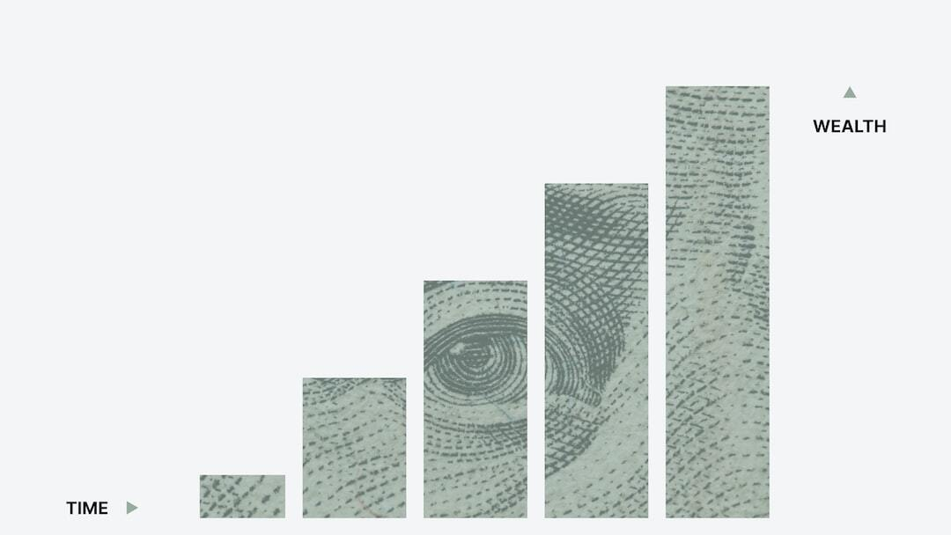
Current State of RDI in the EU
Investment Statistics: Analysis of current RDI investments in EU member states, highlighting the shortfall against the 3% GDP target.
  Global Comparisons: Comparison with investment levels in the US, Japan, and South Korea, showcasing higher RDI investments in these regions.
  Impact on Competitiveness: Examining how the EU's lower investment levels affect its competitiveness on the global stage.

Slide 28

EU State Aid Policy for RDI
Historical Context: Established in 1957, the EU state aid policy aims to create a level playing field among member states.
  Key Features: Comprehensive rules governing the allocation of state aid for RDI to ensure fair competition and avoid market distortions.
  Impact on RDI Investment: State aid policies significantly influence the distribution and effectiveness of RDI funding across the EU.

Slide 29

The ENIRI Study
Purpose and Scope: Examined public RDI support in EU-28 and compared with Australia, Brazil, Canada, China, India, Japan, Russia, South Korea, and the US.
  Methodology: Included a detailed analysis of real-life cases, econometric analysis of public support efficiency, and review of EU state aid rules from 2008-2015.
  Key Findings: Identified restrictive and complex nature of EU state aid rules that hinder effective RDI support.

Slide 30

Challenges Identified
Complexity: EU state aid rules are complex and time-consuming, reducing the effectiveness of RDI support.
  SMEs Barriers: Rules do not cater to the specific needs of SMEs or encourage collaboration with research centers.
  Transparency Issues: The requirement for transparency harms beneficiaries by exposing research details to competitors.
  Inappropriate Presumptions: Assumptions that aid distorts competition may not always be valid.
  Non-functional Matching Clause: The 'matching clause' has never been applied effectively.

Slide 31
Proposed Legal Improvements
Simplification: Reduce the complexity and streamline the approval process for state aid.
  Focus on Fundamental Research: Exclude fundamental research from state aid rules as it has no adverse impact on competition.
  Adjust Aid Intensities: Align with competitors by reducing the number of aid intensity levels.
  Revise RDI Definitions: Use updated categories from Horizon 2020 for better clarity and relevance.
  Operational Matching Clause: Implement a functional matching clause and adapt transparency requirements.

Slide 32
6. Conclusion
Objective: assesses the impact of competition on firm-level innovation and productivity
Contribution:
  Representativeness of sample at worldwide level in terms of
  business R&D expenditures
  Attempt to better define the competition indicators identifying the relevant markets for the firm-sample
  Control for endogeneity of the competition indicator
Main findings:
  Results confirm an inverse U-shaped impact of competition on innovation and productivity growth
  In line with the recent work of Aghion et al (2005, 2009 and 2017).
Notes:
2010/ EU (27 countries) 2.01 Belgium 2.1 United States 2.73 China (except Hong Kong) 1.76 Japan 3.25

Slide 33
6. Conclusion
Policy implications:
  Results of the paper imply that competition policy should be implemented with attention
  Yollies are distinguished as the better performers in innovation and productivity
  When it comes to the small firms and the EU firms, a negative trend of the impact of competition on innovation is observed
  Although the negative impact does not persist significantly on productivity, special attention of the innovation policy makers is needed for these specific firms
What’s next in terms of the research agenda?
  Further analysis is needed to better understand the dynamics of the relationship between competition, innovation and productivity
  Technological complexity
Notes:
2010/ EU (27 countries) 2.01 Belgium 2.1 United States 2.73 China (except Hong Kong) 1.76 Japan 3.25

Slide 34

6. Conclusion
  Better data/indicators to define the relevant market
Notes:
2010/ EU (27 countries) 2.01 Belgium 2.1 United States 2.73 China (except Hong Kong) 1.76 Japan 3.25

Slide 35
Thank you for your attention !
Michele.Cincera@ulb.be

Slide 36
Argentinian paradox: ratio of GDP per capita of Argentina over USA – 1870 - 2013

Slide 37
5. Results / Productivity equation
Variables | Y = Log(Sales)
 | FE | RE | IV - FE | IV – RE
 | (1) | (2) | (3) | (4)
Competition (1 - Lerner) | 14.55*** | 9.826*** | 23.51*** | 16.84***
 | (3.178) | (2.982) | (6.209) | (5.736)
Competition – Squared | -8.762*** | -5.742*** | -14.19*** | -9.702***
 | (1.855) | (1.748) | (3.648) | (3.346)
N° Employee - Log | 0.477*** | 0.527*** | 0.532*** | 0.564***
 | (0.0409) | (0.0325) | (0.0382) | (0.0272)
Physical capital stock - Log | 0.226*** | 0.340*** | 0.231*** | 0.339***
 | (0.0518) | (0.0324) | (0.0551) | (0.0309)
R&D stock - Log | 0.212*** | 0.171*** | 0.154*** | 0.151***
 | (0.0333) | (0.0210) | (0.0373) | (0.0209)
Year dummy | YES | YES | YES | YES
Constant | -5.542*** | -4.646*** | -9.356*** | -7.933***
 | (1.322) | (1.270) | (2.558) | (2.442)
Observations | 12,283 | 12,283 | 11,912 | 11,912
N° of firms | 1,867 | 1,867 | 1,862 | 1,862
R-squared | 0.477 | 0.4723 | 0.4705 | 0.4666
Wald test - H0: All coefficient = 0 | 0.0000 | 0.0000 | 0.0000 | 0.0000
Hausman test - H0: differences in coefficients not systematic | 0.0000 |  | 0.0000
Endogenous variables | NO | NO | Competition (level and squared) and R&D Stock
Instruments | - | - | L(1/2).Competition (level and squared) and L.R&D Stock
Sargan-Hansen test - H0: overidentifying restrictions are valid | - | - | 0.5684 | 0.0127
Source: Author’ own elaboration.
Note: Robust standard errors in parentheses. Significance level: *** p<0.01, ** p<0.05, * p<0.1.
Notes:
2010/ EU (27 countries) 2.01 Belgium 2.1 United States 2.73 China (except Hong Kong) 1.76 Japan 3.25

Slide 38
5. Results / Productivity equation
Figure 7. Estimated relationship between competition and production
Source: Author’ own elaboration.
Note: Figure based on the results of IV-FE. Production is measured by the Log of Sales.
Notes:
2010/ EU (27 countries) 2.01 Belgium 2.1 United States 2.73 China (except Hong Kong) 1.76 Japan 3.25

Slide 39
5. Results / Productivity equation
Figure 8. Estimated relationship between competition and production: Yollies
Source: Author’ own elaboration.
Note: Robust standard errors in parentheses. Significance level: *** p<0.01, ** p<0.05, * p<0.1.
Notes:
2010/ EU (27 countries) 2.01 Belgium 2.1 United States 2.73 China (except Hong Kong) 1.76 Japan 3.25

Slide 40
Context
Specific contract under the Multiple Service Framework Contract N°2018/RTD/A2/OP/PP07001-2018 to support the development, analysis and evaluation of R&D policy at the EU level
  Prof. Dr. Ali Bayar, ULB Solvay and ECOMOD
  Prof. Dr. Guido Cozzi, Department of Economics, University of St. Gallen
  Prof. Dr. Giammario Impullitti, School of Economics, University of Nottingham
  Prof. Dr. Michele Cincera, ULB Solvay

Slide 41
Context
Elaboration of the extension of two existing models used within the European Commission
HETFIGE is a heterogeneous firms general equilibrium model for a closed economy
RHOMOLO is a dynamic spatial computable general equilibrium model
The HETFIGE model is extended with an open-economy module
The RHOMOLO model is extended with two modules:
  scale-free endogenous R&D driven growth and
  the introduction of heterogeneous firms

