Slide 1
Peer Review on Reference budgets
Reference budgets in Luxembourg and their use
Jérôme Hury
Antwerpen -18/09/2018

Slide 2

3 549 €
Is this enough for a decent life?
This amount is the relative poverty line for a family with 2 kids.

Slide 3
The starting point
Is the relative poverty threshold too high?
What are the minimum needs to live decently in Luxembourg and to participate actively in society?
Why a RB for LU?
  To stimulate the debate on poverty
  To benchmark for the (European) other poverty and deprivation indicators
  To make comparisons with the minimum thresholds
  To evaluate adequacy of protection systems against poverty
  To help NGOs in their daily work
  To develop budget counseling programs for households in financial difficulty
But no official policy use for the moment
Notes:
3 549 EUR for a family with 2 children

Slide 4
Towards a reference budget for Luxembourg
Pilot Project
In 2010
Borsi and al.
New Project
In 2014-2016
Franziskus
Final report
Release December 2016
Franziskus
RB update
Release August 2018
Frising, Hury
Project carried out in the context of :
ImPRovE (FP7): 7 countries, 2012-2016
EU Reference Budgets Network Pilot Project: 28 pays, 2014-2015
Notes:
We started long time ago with a pilot

Slide 5

Governance
Project carried out by STATEC
Supervision by a national steering group :
  Governemental bodies: STATEC (NSI), Ministry of familly and integration, General Inspectorate of Social Security (IGSS)
  NGOs: Caritas, Social Medical League, Co-labor
Participation of Focus Groups
Notes:
Operational work done by STATEC: 1 person full time equivalent
Steering groups to validate the choices in some cases more difficult (example housing)
Focus groups of people in difficult situations:
So people experiencing poverty were part of the process
-Focus groups Help build some baskets (social life)
-Check social acceptability of baskets
3 focus groups to check basic assumptions of the project and discuss food basket (December 2014)
3 focus groups to discuss social life baskets, children's needs and lifelong learning (April-May 2016)

Slide 6
Methodological approach
Two-step approach:
  Identification of basic needs
    What is the right living standard?
    Keeping in mind that: The RB should allow individuals to fulfill their different roles and social functions (family, professional, etc.)
  Pricing of the baskets
    CPI database, Internet price collection
    What is the right price? Hard discount vs. traditional supermarket
    One of the most difficult : housing
Notes:
3 data sources to define the contents of the baskets
-International and national legal standards
-Scientific research and expert knowledge
-Focus groups Help build some baskets (social life)
-Check social acceptability of baskets
Needs for food are quite easy define: international norms and recommandations by World Heath organisation
Pricing:
Not the cheapest product, but the second cheapest allow for some flexibility in the choices
Some prices are regulated and therfore straight forward (i.e. public transport)

Slide 7
The reference family
Asumptions:
All are healthy
Both adults are working fulltime
Kids go to school (primary and secondary)
Capable of taking well informed economic decisions
Live in an urban region but not in the capital city
Live in a flat in good condition
Four types of households:
Singles (m / f)
Couple without children
Singles with 1 child
Couple with 2 children
45 years
14 years
10 years

Slide 8
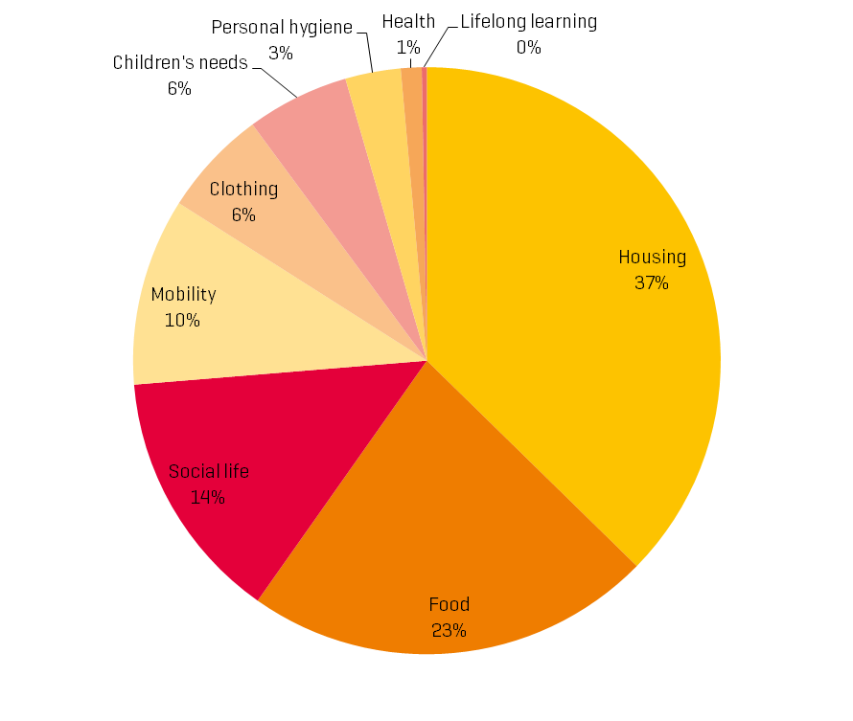
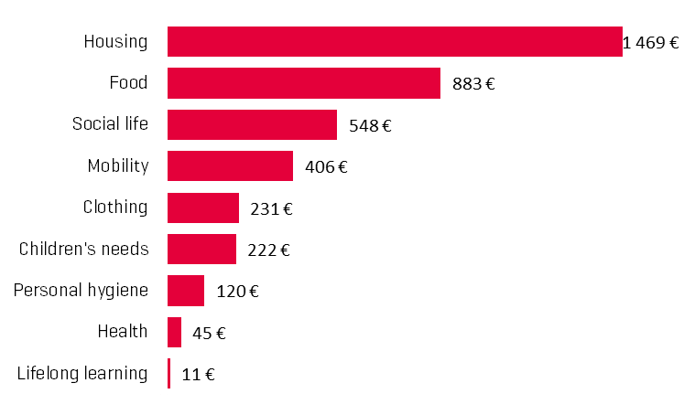
The results in 2016 for our family
3 935 EUR a month
Notes:
Housing and food alone represent 60% of the total budget

Slide 9

3 549 €
NO! This is not enough for a decent life!
According to the reference budget for Luxembourg for our family.

Slide 10
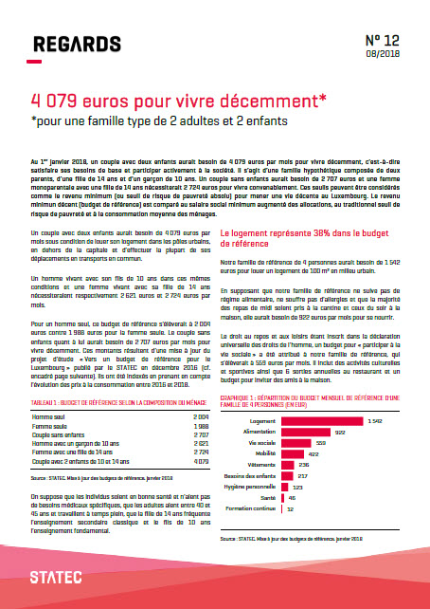
Price updating the baskets in 2018
four types of households Singles (m / f) Couple without children Singles with 1 child Couple with 2 children
No revision of baskets
Only using inflation measured by the national Consumer Price Index (CPI)
Publication in August 2018
Link: http://statistiques.public.lu/fr/publications/series/regards/2018/12-18-4079-euros-pour-vivre-decemment/index.html

Slide 11
The results in 2018
Notes:
A couple with two children would need 4 079 euros per month provided they rent their housing in urban centers, outside the capital and make most of their trips by public transport.
A man living with his 10-year-old son under the same conditions and a woman living with her 14-year-old daughter would require 2 621 euros and 2 724 euros per month respectively.
For a single man, this reference budget would amount to 2 004 euros against 1 988 euros for the single woman. The couple without children meanwhile would need 2 707 euros per month to live decently.

Slide 12
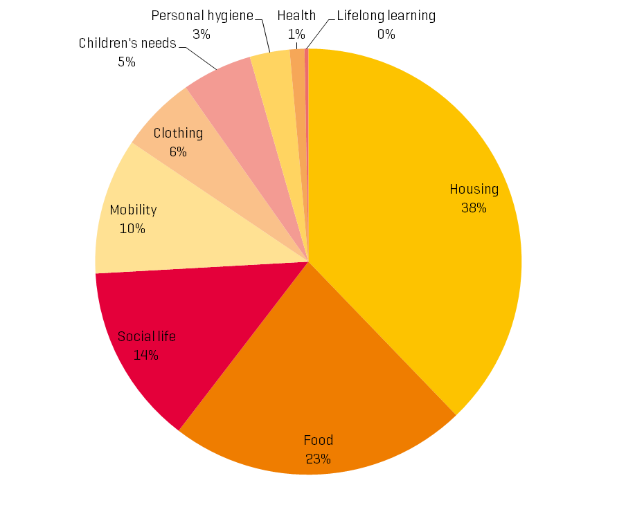
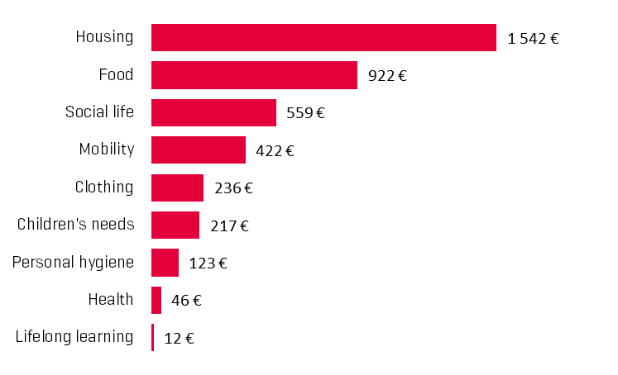

The results in 2018 for our family
4 079 EUR a month
Notes:
Our reference family e of 4 people would need 1 542 euros to rent a flat of 100 m2 in an urban environment in LU
Assuming that our reference family does not follow a diet, does not suffer from allergies and that the majority of lunch is taken in the canteen and the dinner in the evening is taken at home at home, she would need 922 euros per month for eating.
The budget for "participating in social life" allocated to our family, would amount to 559 euros per month. It includes cultural and sports activities as well as 6 times a year dinning out in a restaurant and a budget to invite friends at home.
Housing is even more import than in 2016 (+1% share in the total basket) and Children’s needs (-1% share in the total basket – reform of the children’s day care system. the system is more generous in 2018 than in 2016

Slide 13
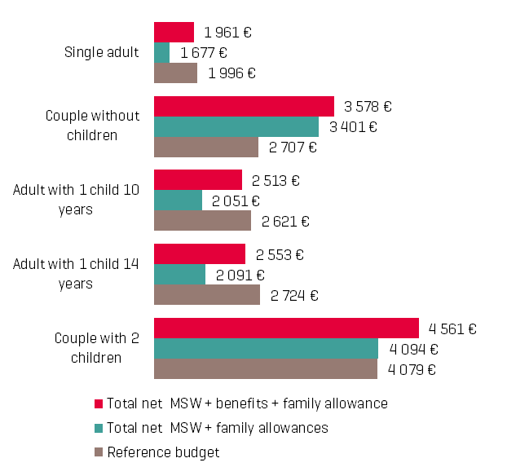
Comparing the RB to the minimum social wage (MSW)
four types of households Singles (m / f) Couple without children Singles with 1 child Couple with 2 children
“State aid does not always lead to a decent life”
Notes:
The minimum social wage applies to all employees (regardless of gender, to all types of occupations and contract and for all companies)
Since the provisions relating to the social wage are of a public nature, this minimum social wage must be paid by all employers carrying on business in Luxembourg.
The minimum social wage rates are set according to the age and the qualification of the beneficiaries
Given that the reference budget is based on the assumption that the adult (s) of the household are working, it should be compared to the minimum social wage, which is income from paid employment.
In this Figure, the reference budget is first compared to the net minimum social wage plus all possible benefits and allowances, (namely: the cost of living allowance, the rent subsidy, the family allowances, the single-parent tax credit, the employee tax credit and the back-to-school allowance.
This analysis shows that the MSW in combination with all social benefits covers the total basic needs of households without children and couples with two children. However 35 euros are missing per month for the single adult, 108 euros for the single parent with a child of 10 years and 171 euros for the one with a child of 14 to participate actively in society.
State aid therefore seems insufficient to lead a decent life for some household types.
Next, we compare the reference budget with the net minimum social wage, to which we add only the family and back-to-school allowances.
It is assumed that households are not entitled to the other benefits.
It can be seen that without state aid, only 100% active couples without children keep incomes well above the reference budget.
100% working couples with two children are just in the reference budget, thanks to family allowance.
Figure 3 clearly highlights the importance of different state benefits and benefits for a family with two children. Their only income from work represents only 83% of the reference budget. (allowance for future of children), the single-parent tax credit, the employee tax credit and the back-to-school allowance. It shows that the SSM in combination with all social benefits covers the total basic needs of households without children and couples with two children. It is missing, however, 35 euros per month for the adult alone, 108 euros for the single parent with a child of 10 years and 171 euros for the one with a child of 14 to participate actively in society. State aid therefore seems insufficient to lead a decent life according to the methodology of the reference budget.
Next, we compare the reference budget with the net minimum social wage, to which we add only the family and back-to-school allowances. It is assumed that households are not entitled to an expensive living allowance, rent subsidy or tax credits. It can be seen that without state aid, only 100% active couples without children keep incomes well above the reference budget. 100% working couples with two children are just in the reference budget, thanks to child benefit allocations. Figure 3 clearly highlights the importance of different state benefits and benefits for a family with two children. Their only income from work represents only 83% of the reference budget.

Slide 14
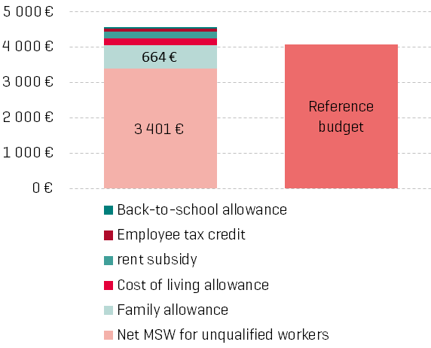
Comparing the RB to the minimum social wage (MSW)
four types of households Singles (m / f) Couple without children Singles with 1 child Couple with 2 children
“For a family with 2 children additional 1 160 EUR of state aids lead to a decent life”
Notes:
This figure clearly highlights the importance of different state benefits for a family with two children. Their only income from work represents only 83% of the reference budget.

Slide 15
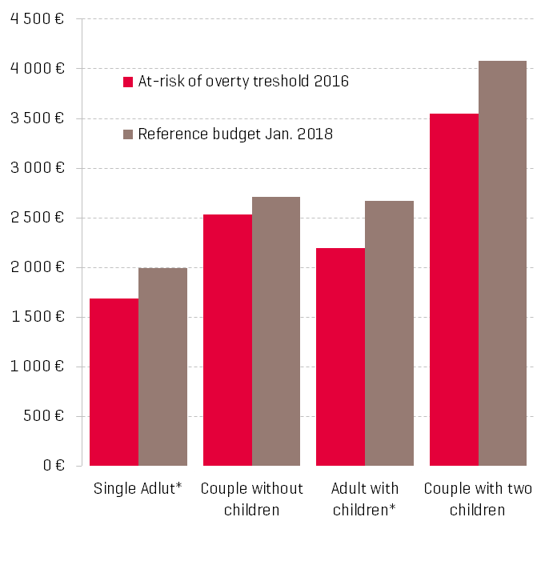
Comparing the RB to the at-risk-of-poverty threshold
“16.5% of the population considered as poor in Luxembourg according to the relative poverty definition can not participate actively in society”
Notes:
It is also relevant to compare the reference budget with the national poverty line to determine whether people living with the poverty threshold income can meet basic needs and participate actively in society.
The poverty risk threshold corresponds to 60% of median equivalised disposable income, € 1,690 per adult equivalent.
It appears that for all our households, the reference budget is higher than the risk of poverty threshold. In other words, persons or households living with an income up to the at-risk-of-poverty threshold can not lead a decent life in Luxembourg.
The only adults living with an income up to the threshold of risk of poverty lack of 306 euros per month, couples with two children lack of 529 euros per month to participate properly in society.
The risk of poverty threshold is therefore clearly too low to live decently in Luxembourg.
The 16.5% of the population considered as poor in Luxembourg according to the relative poverty definition can not participate actively in society. These are 92 000 persons.
A poverty risk threshold corresponding to 70% of median disposable income would therefore be much closer to the reference budget.

Slide 16
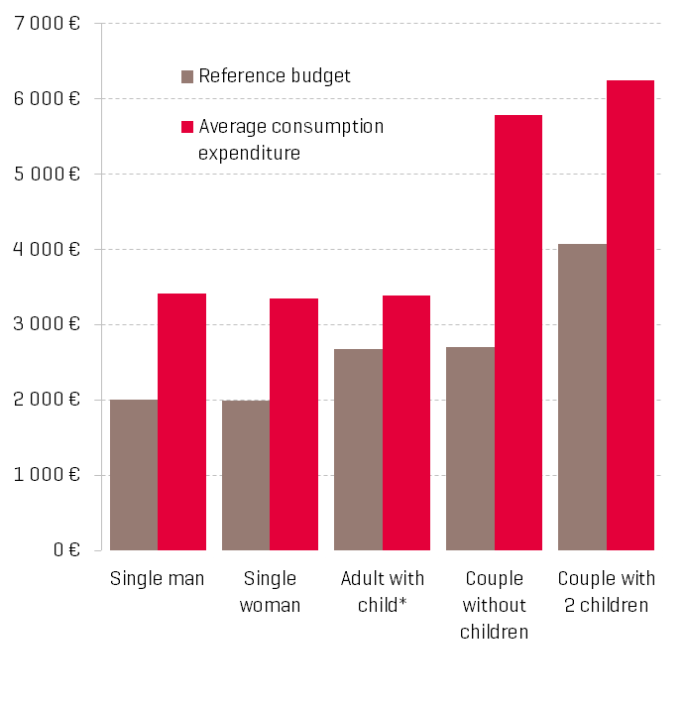
Comparing the RB to the average consumption expenditure
“The average living standard is much higher than the reference budget”
Notes:
Finally, a final comparison is that of the reference budget to the average monthly expenditure of all households in LU.
According to the household budget survey of 2016, a single man would spend an average of 3 412 EUR per month, a single woman 3 349 EUR, a couple without children 5 782 EUR and a couple with two children 6 250 EUR.
A single-parent family with a child would spend an average of 3 390 euros, less than a single man and little more than a single woman.
Note that this is the average monthly expenditure of all households including wealthy households in LU.
These monthly average expenditures can be considered as an indicator of average living standards.
The table shows that the reference budget is significantly lower than these average expenditures. Depending on the type of household, the reference budget represents between 47% and 79% of what the same type of household spends on average.
Specifically, a family with two children, who have just enough money to lead a decent life and participate in the workforce, has 35% less monthly budget per month than this type of family actually spends on average in LU, ie this represents 2 171 EUR per month.

Slide 17
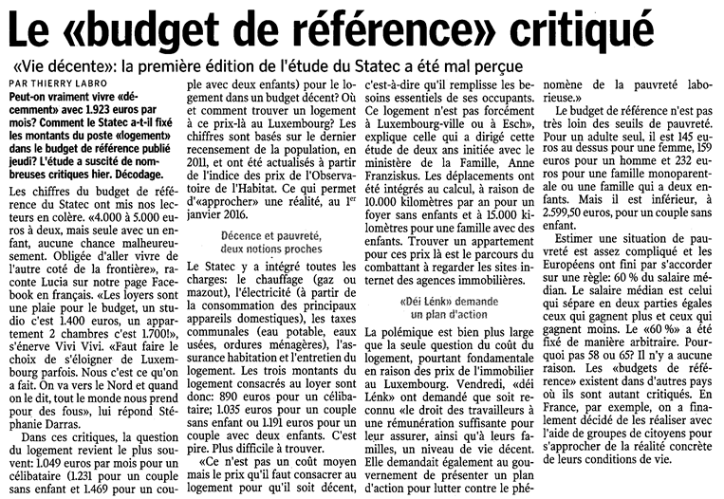
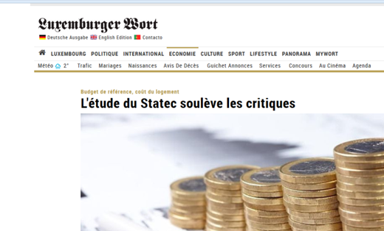
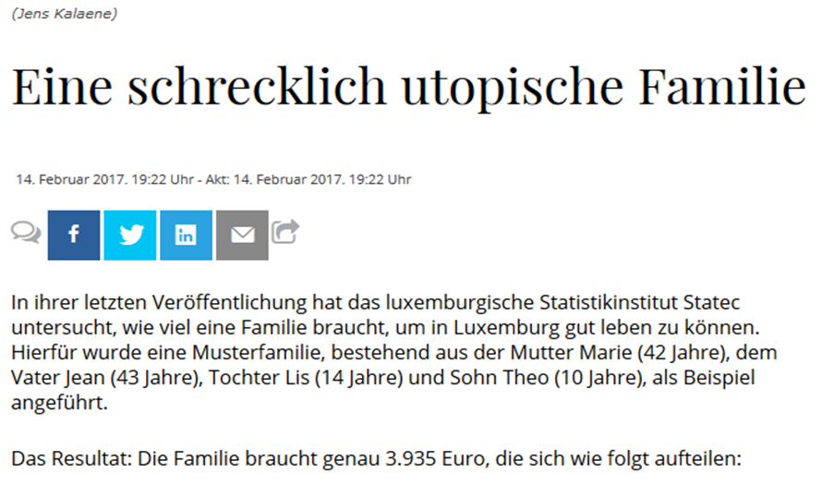
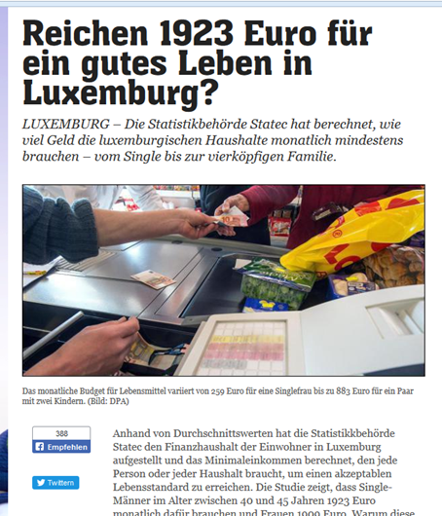
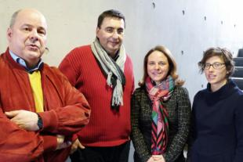
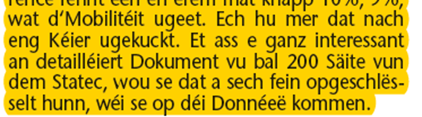
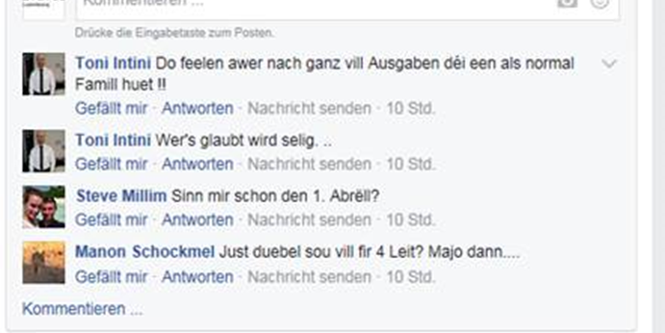
Very good media coverage…
…but lots of criticism

Slide 18
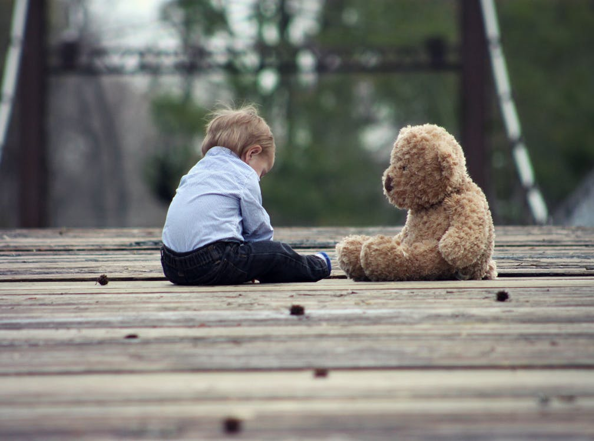
Future plans
Compare RB to the recently voted minimum income (REVIS=Revenu d‘inclusion sociale)
Complete revision of the baskets and pricing every 4-5 years (2019?)
Extension to other household types – populations
  Early childhood (policy need)
  Third Age
  Non active people
Notes:
REVIS
Complete revision of the baskets and pricing every 4-5 years (2019?): Also to include the changes induced by social policy reforms

Slide 19
Thank you for your attention !
Contact:
jerome.hury@statec.etat.lu
+352 247 88474

